Slide 1
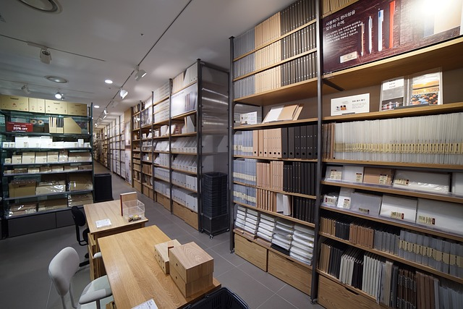


Slide 2

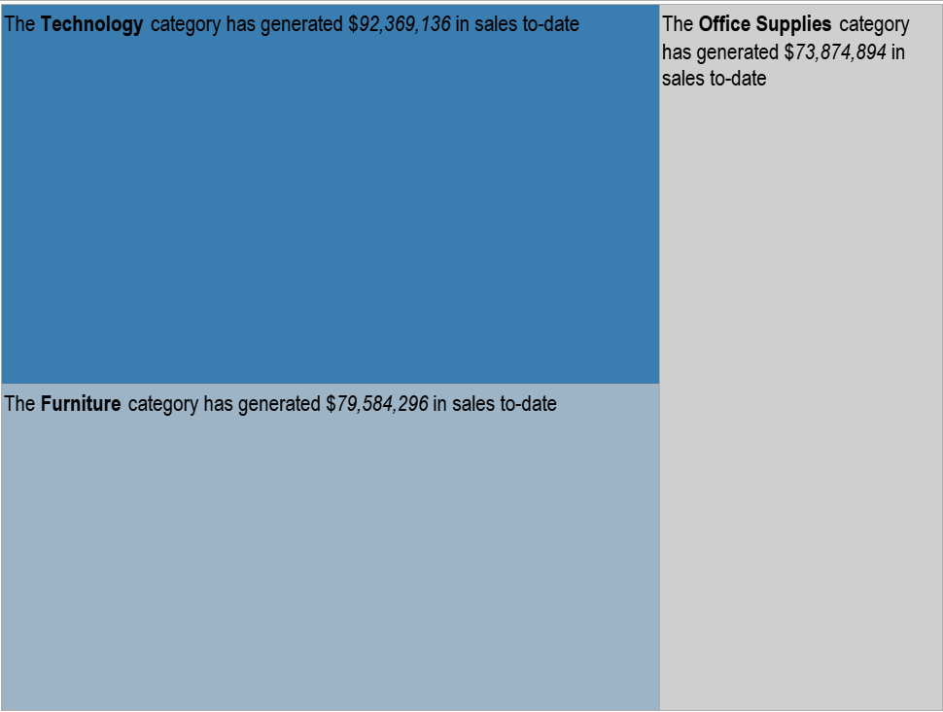

Slide 3
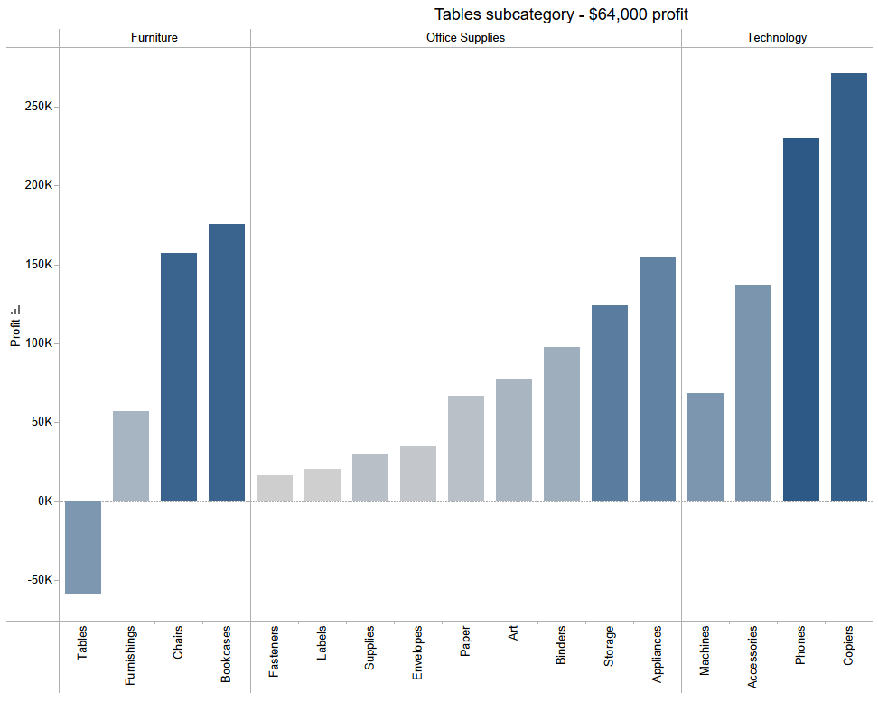

Slide 4


All other sub-categories in the ‘Furniture’ category are faring better than ‘Tables’ in Superstore.
To increase profit:
promote tables across segments
focus on corporate clients
historically make large routine purposes i.e. tables, desks, furniture for office purposes.

Slide 5

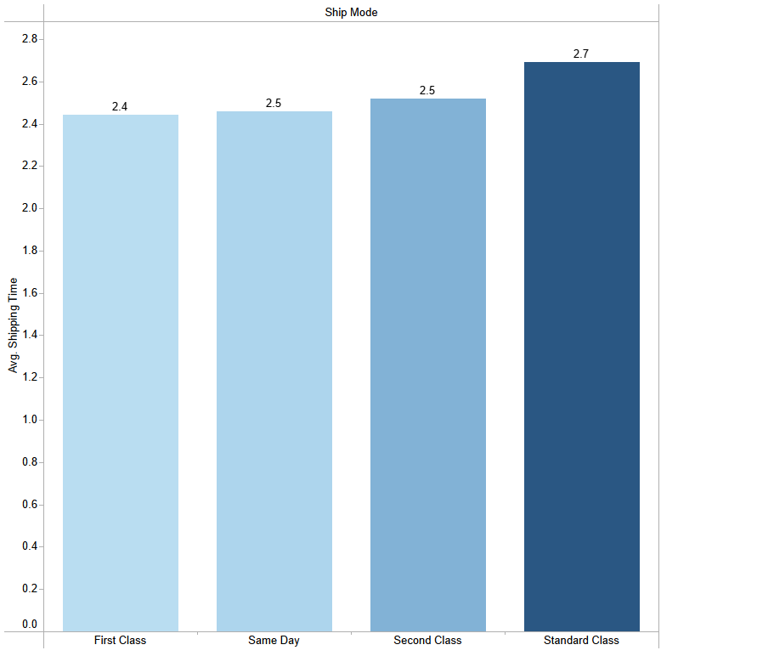
Standard class has the highest average ship time overall
First Class – 2.4 avg
Same Day – 2.5 avg
Second Day – 2.5 avg
Standard Class – 2.7 avg

Slide 6
Corporate segment is steadily ordering tables. • Offer first class shipping to corporate consumers - entice spending - increase corporate account use
Standard class experiencing highest shipping delays
The further the distance, from U.S. to foreign territories, longer item takes to ship.
Longer arrival time – damaged, lost-in-transit
Client may opt for closer alternatives!

